Slide 1


DATA MINING FALL 2024
NBA SALARIES 22’-23’
BY: MUHAMMAD RIZWAN, MAHMOUD AWAD, AND KEVIN BETHEL

Slide 2

INTRODUCTION
Objective:
To analyze NBA player salaries and performance metrics using advanced data analysis techniques.
Motivation:
To uncover insights into salary distribution, performance correlations, and statistical anomalies that shape team strategies and player valuation.
Dataset Overview:
Source: NBA 2022-2023 Dataset from Kaggle
Composition: 467 rows and 52 columns
Data Types: Numerical, Categorical, Integer
1

Slide 3
DATASET OVERVIEW
Key Features:
Numerical Data: Per Game (PTS), True Shooting Percentage (TS%), Player Efficiency Rating (PER).
Categorical Data: Player Name, Position, Team.
Integer Data: Games Played (GP), Field Goals Made (FG).
Summary Statistics:
Salary: Mean = $8.42M, Max = $48.07M.
PTS: Mean = 9.13, Max = 33.1.
Minutes Played (MP): Mean = 19.87, Std Dev = 9.55.
2

Slide 4

DATA CLEANING
Challenges:
Missing values in key columns (e.g., FG%, TS%).
Outliers in features like Salary, Blocks, and Assists.
High skewness in numerical data.
Solutions:
Trimming Columns: Retained essential performance and financial metrics.
Handling Missing Values: Imputed missing values or removed rows with critical data gaps.
Outlier Monitoring: Preserved outliers for context but tracked their impact on models.
Normalization: Applied StandardScaler for consistent feature scaling.
3

Slide 5
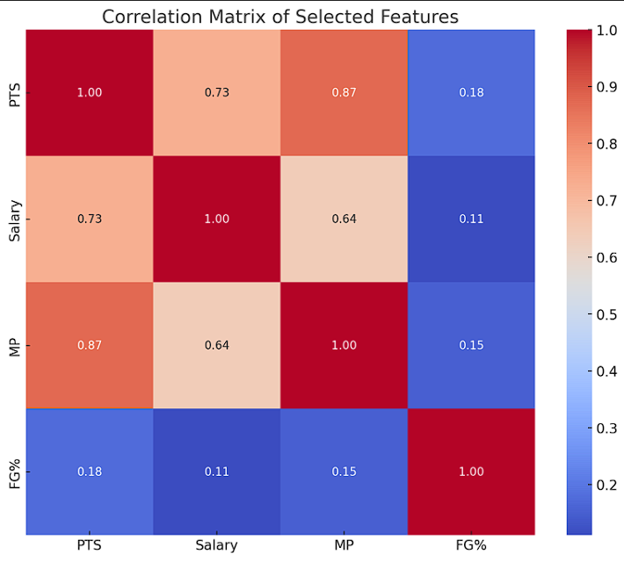
DATA ANALYSIS
Purpose: The heatmap highlights relationships among numerical features, identifying key drivers of player salaries and performance.
Key Insights:
Strong Correlations:
PTS, MP, and FG% are highly correlated with Salary, reflecting performance-based valuation.
Moderate Correlations:
TS% and PER show consistent but weaker ties to Salary.
Implications:
These insights guide model feature selection and highlight metrics that drive player contracts.
4

Slide 6

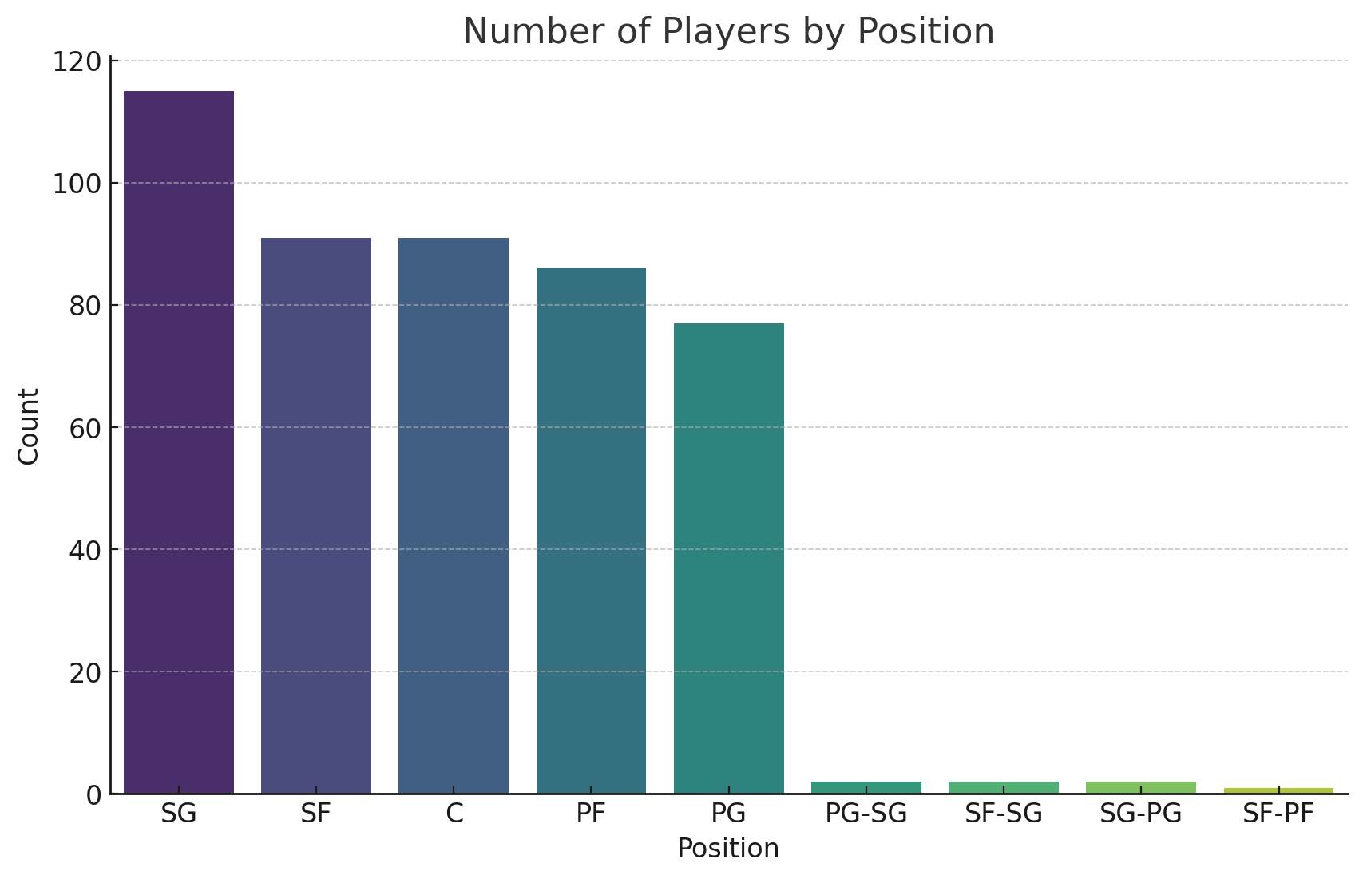
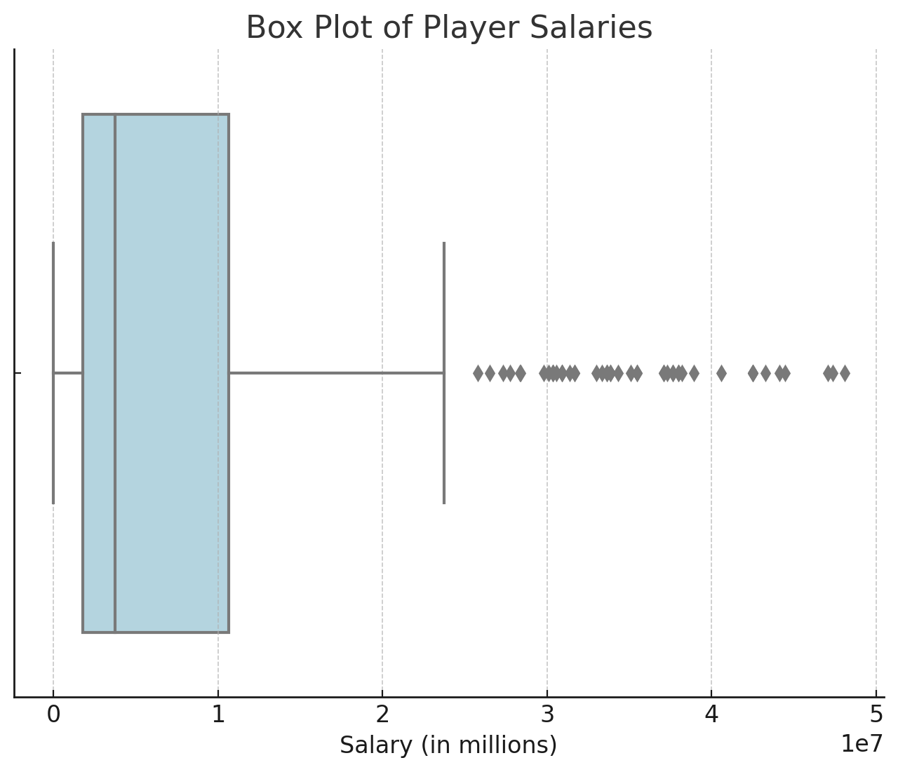
BAR CHART/BOX PLOT
Box plot highlighted salary outliers exceeding $40M. The bar chart showed guards had the highest positional variability. Salary, FT, and BLK were positively skewed, FG% and TS% slightly negatively skewed, and GP and PF symmetrically distributed.
5

Slide 7
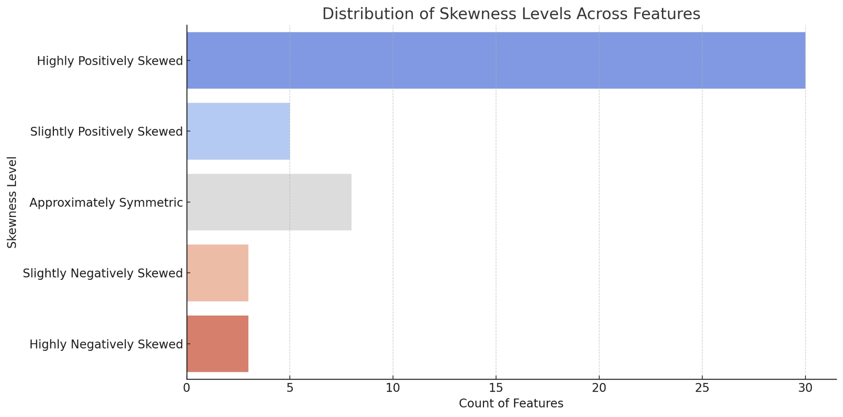
SKEWNESS
Key Observations:
Highly Positively Skewed Features:
Examples: Salary, Free Throws, Blocks.
Implications: Most players earn below-average salaries, with a small number of players earning exceptionally high amounts. Similarly, only a few players excel in free throws and blocks, creating outliers.
Approximately Symmetric Features:
Examples: Games Played (GP), Personal Fouls (PF).
Insights: These features reflect balanced distributions, likely influenced by standard player participation and consistent gameplay patterns.
Slightly Negatively Skewed Features:
Examples: Field Goal Percentage (FG%), True Shooting Percentage (TS%).
Impact: Higher efficiency metrics for most players suggest an emphasis on improving shooting accuracy across the league.
6

Slide 8
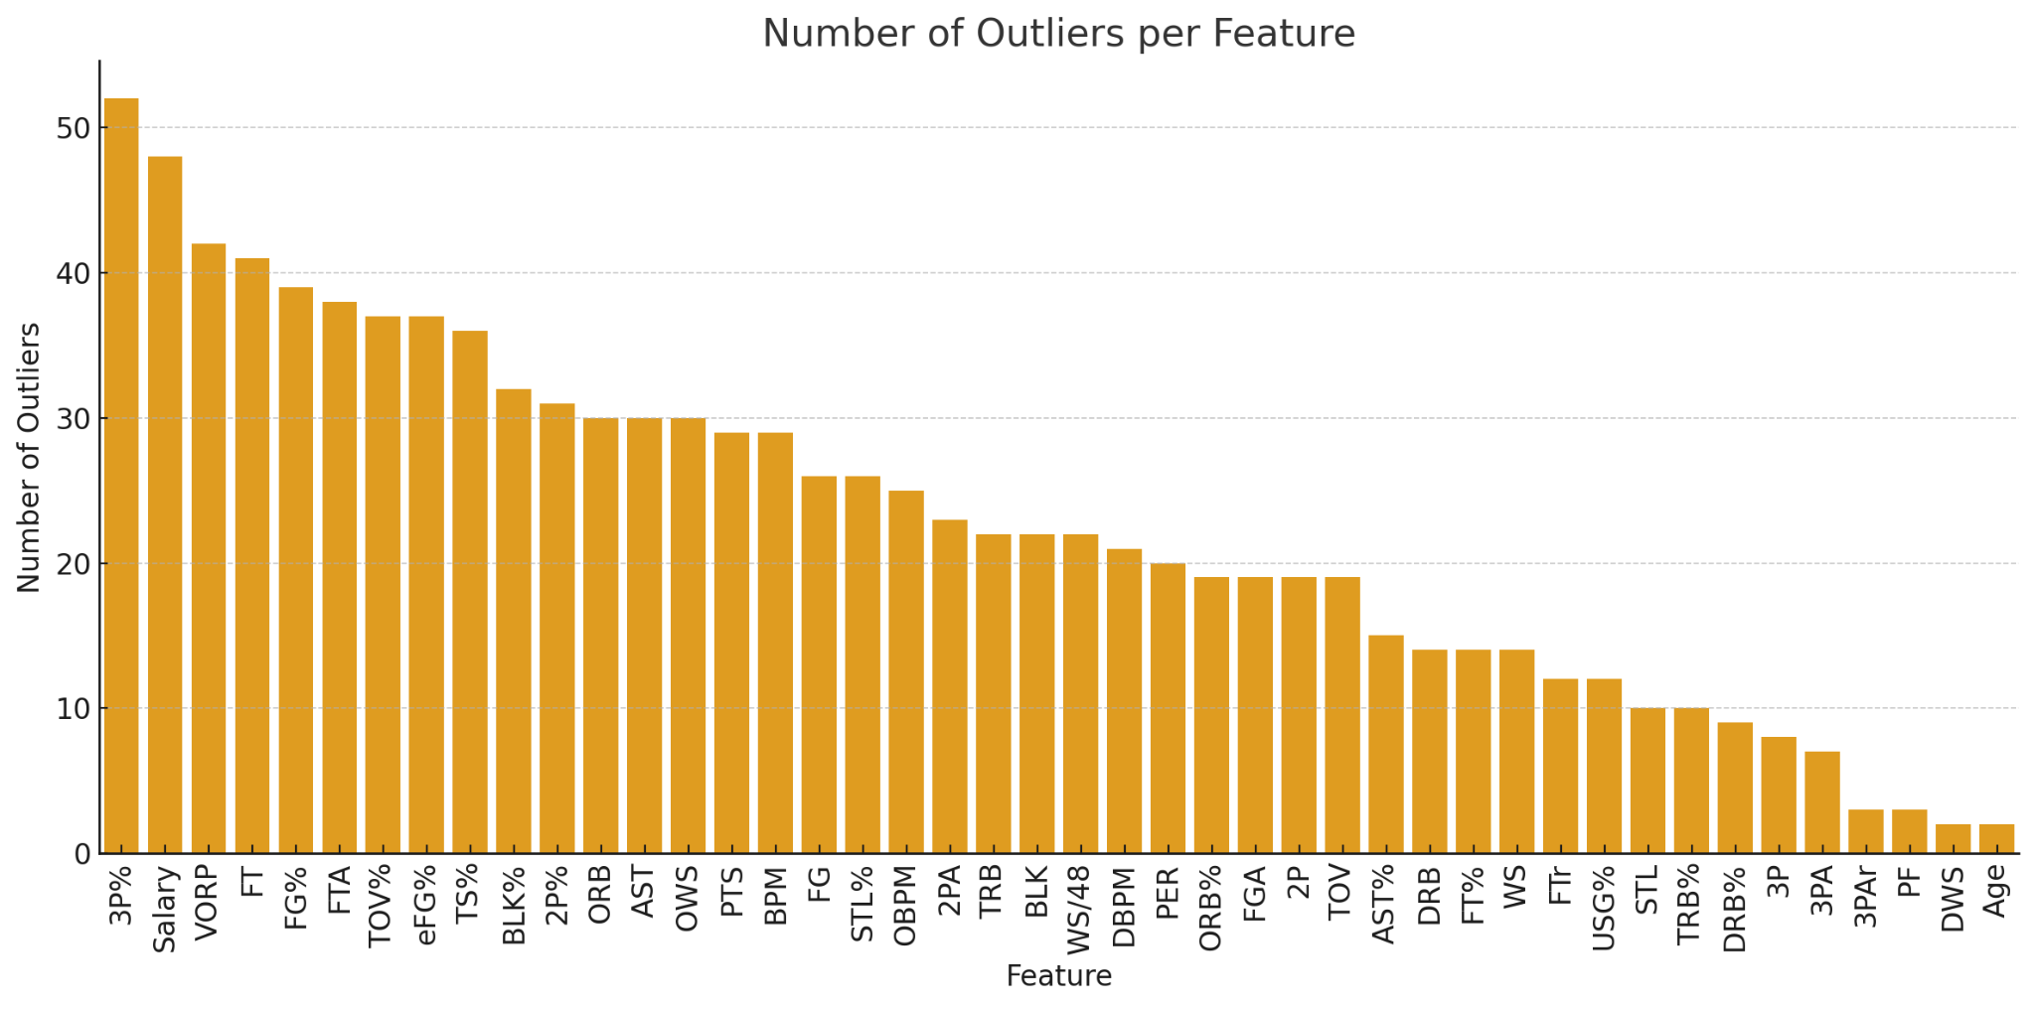
OUTLIERS
Key Findings:
Salary Outliers:
Count: 48 data points significantly outside the expected range.
Insight: Reflects the extraordinary salaries of top players, such as superstars with max contracts.
Free Throws (FT) and Free Throws Attempted (FTA):
Counts: FT = 41, FTA = 38.
Insight: Indicates rare cases of players excelling as high-volume free throw shooters, contributing significantly to team scoring.
Other Notable Outliers:
Offensive Rebounds: 30 instances.
Assists: 30 instances.
Blocks: 22 instances.
Insight: Highlights a select group of players who excel in these specialized areas, shaping team performance.
7

Slide 9

DECISION TREE/ SVM MODELS
Decision Tree:
Designed for simplicity and interpreting non-linear relationships.
Offers quick training and explainable results, making it suitable for understanding key decision factors.
Support Vector Machine (SVM):
Optimized for accuracy and handling high-dimensional data.
Delivers robust performance, particularly in complex datasets.
Dataset Splits:
80-20 Split: 373 training rows, 94 testing rows.
70-30 Split: 326 training rows, 141 testing rows.
Split | Model | Mean Square Error (MSE) | R^2 Score
80-20 Split | Decision Tree | 0.0924 | 0.9362
80-20 Split | SVM | 0.0516 | 0.9644
70-30 Split | Decision Tree | 0.1104 | 0.9159
70-30 Split | SVM | 0.0498 | 0.9621
8

Slide 10
MODEL COMPARISON
Decision Tree:
Strengths:
Speed: Quick to train, making it efficient for large datasets or initial exploratory modeling.
Interpretability: Produces a clear set of rules, enabling easy understanding of how features contribute to predictions.
Non-linear Relationships: Handles complex patterns without requiring feature transformation or scaling.
Weaknesses:
Overfitting: Prone to capturing noise in the data, especially with deep trees or small datasets.
Tuning Requirements: Requires careful adjustment of hyperparameters like max_depth and min_samples_split to balance bias and variance.
Support Vector Machine (SVM):
Strengths:
Accuracy: Excels in handling high-dimensional and complex datasets, achieving superior predictive performance.
Overfitting Resistance: Regularization and kernel functions (e.g., RBF) help prevent overfitting even in noisy data.
Flexibility: Can model linear and non-linear relationships through different kernel choices, adapting to diverse data structures.
Weaknesses:
Computation: Computationally intensive, especially with large datasets, as it scales poorly with the number of samples.
Interpretability: Lacks intuitive transparency, making it harder to explain results compared to Decision Trees.
9

Slide 11
INTERPRETATION OF RESULTS
Performance Metrics:
SVM:
Achieved higher R² scores (up to 0.9644) and F1 scores (0.9816), showcasing superior accuracy.
Generalized effectively across both 80-20 and 70-30 dataset splits, ensuring consistent performance.
Decision Tree:
Provided a simpler, interpretable alternative with respectable performance.
Required careful tuning to prevent overfitting, particularly with deeper trees.
Key Factors Influencing Results:
Feature Normalization:
Enhanced SVM's ability to handle high-dimensional data by improving scale consistency across features.
Handling Missing Values and Outliers:
Ensured unbiased results by addressing potential distortions in the data during preprocessing.
10

Slide 12
REAL-WORLD APPLICATIONS
Key Insights:
Salary Correlations:
Heatmaps reveal strong connections between Salary and performance metrics like Points Per Game (PPG) and Minutes Played (MP).
Highlights the importance of individual contributions in driving financial valuations.
Model Applications:
SVM:
Excels in predicting player value with high accuracy.
Useful for identifying star performers based on complex performance metrics.
Decision Tree:
Provides interpretable results for understanding salary differences and player rankings.
Simplifies complex analyses for clearer communication with stakeholders.
Real-World Impact:
Salary Optimization:
Assists teams in aligning player contracts with performance metrics.
Draft Strategy:
Identifies high-potential players using predictive modeling.
Fan Engagement:
Creates understandable analytics, enhancing transparency and fostering stronger connections with fans.
11

Slide 13
CONCLUSION
Best Performing Model:
Support Vector Machine (SVM): Superior accuracy and robustness in handling complex relationships.
Key Takeaways:
SVM outperformed Decision Tree across all metrics, making it ideal for predictive tasks.
Decision Tree remains valuable for interpretable and quick analyses.
Broader Implications:
Guides data-driven decisions in player contracts, draft strategies, and team management.
Highlights the importance of performance metrics in shaping financial and strategic outcomes.
12

Slide 14


QUESTIONS?
13

